Slide 1
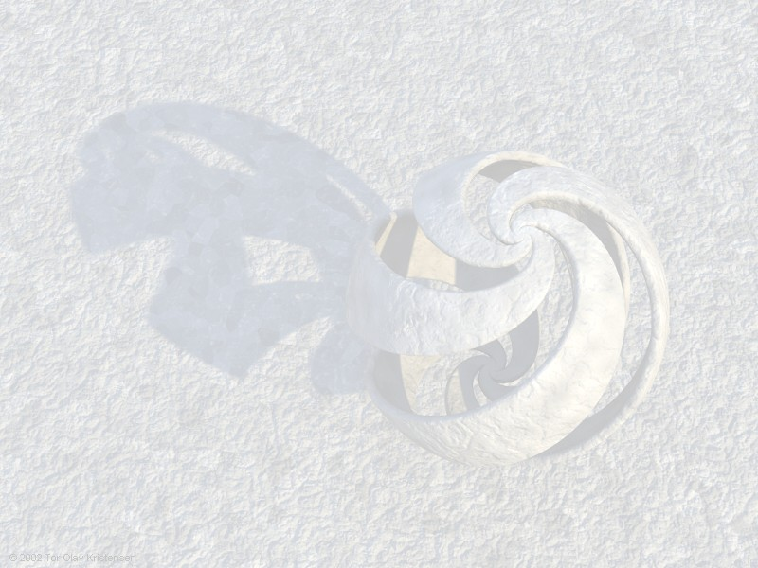
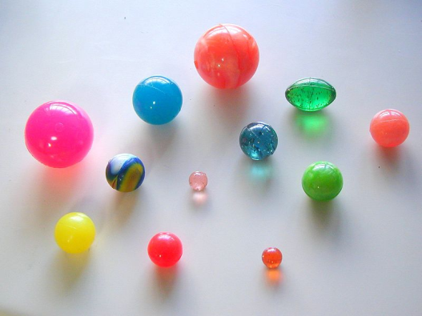
Super Balls
  Mitsuo I. Tsumagari
  Supervisor: Ed Copeland
  University of Nottingham
  Overview: 1) Definition 2) History
  3) Stability 4) Our work
Notations:
Q : U(1) charge (angular momentum)
w : angular velocity
[arxiv: 0805.3233, 0905.0125]

Slide 2
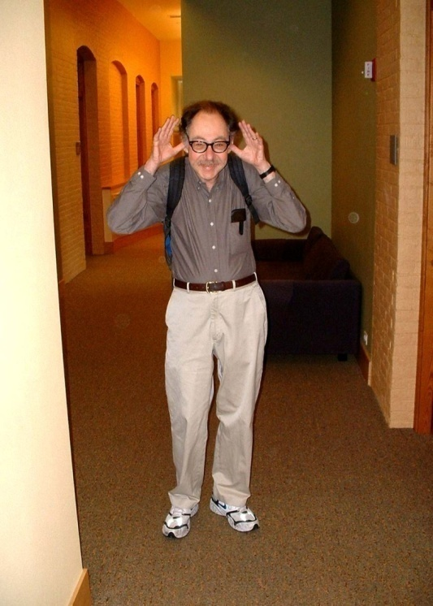
What is a Q -ball ?
[Friedberg et. al. ‘76; S.R. Coleman ’85]
Q-ball is a localised energetic sphere
(non-topolotical soliton)‏ and is the lowest energy solution with global U(1) charge Q
(internal spin with angular velocity )‏
Non-topological solitons e.g. Q-balls, gauged Q-balls, bosonic stars, etc…
  Stability by Noether charge Q
  Time-dependent (stationary)
  Any spatial dimensions
Topological solitons e.g. kinks,cosmic strings, skyrmions
  Stability by Topological charge
  Time-independent (static)
  Restricted number of spatial dimensions

Slide 3
Past works on Q-balls
Non-topological solitons, Q-balls [Friedberg et. al. ‘76; S.R. Coleman ’85]
Bosonic stars (Q-balls in GR) [T.D. Lee, Y. Pang ‘89]
Self-dual Chern-Simons solitons [R. Jackiw, K. Lee, E. J. Weinberg ‘90]
(SUSY) Q-balls in minimal supersymmetric SM (MSSM)
[A. Kusenko, M. Shaposhnikov ‘97]
Candidate of dark matter [A. Kusenko, M. Shaposhnikov ‘97]
Source of gravitational waves [MIT ’08, A. Kusenko, A. Mazumdar ‘08]

Slide 4
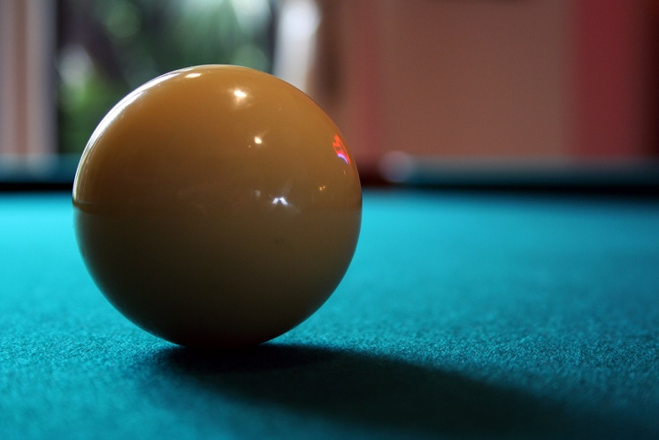
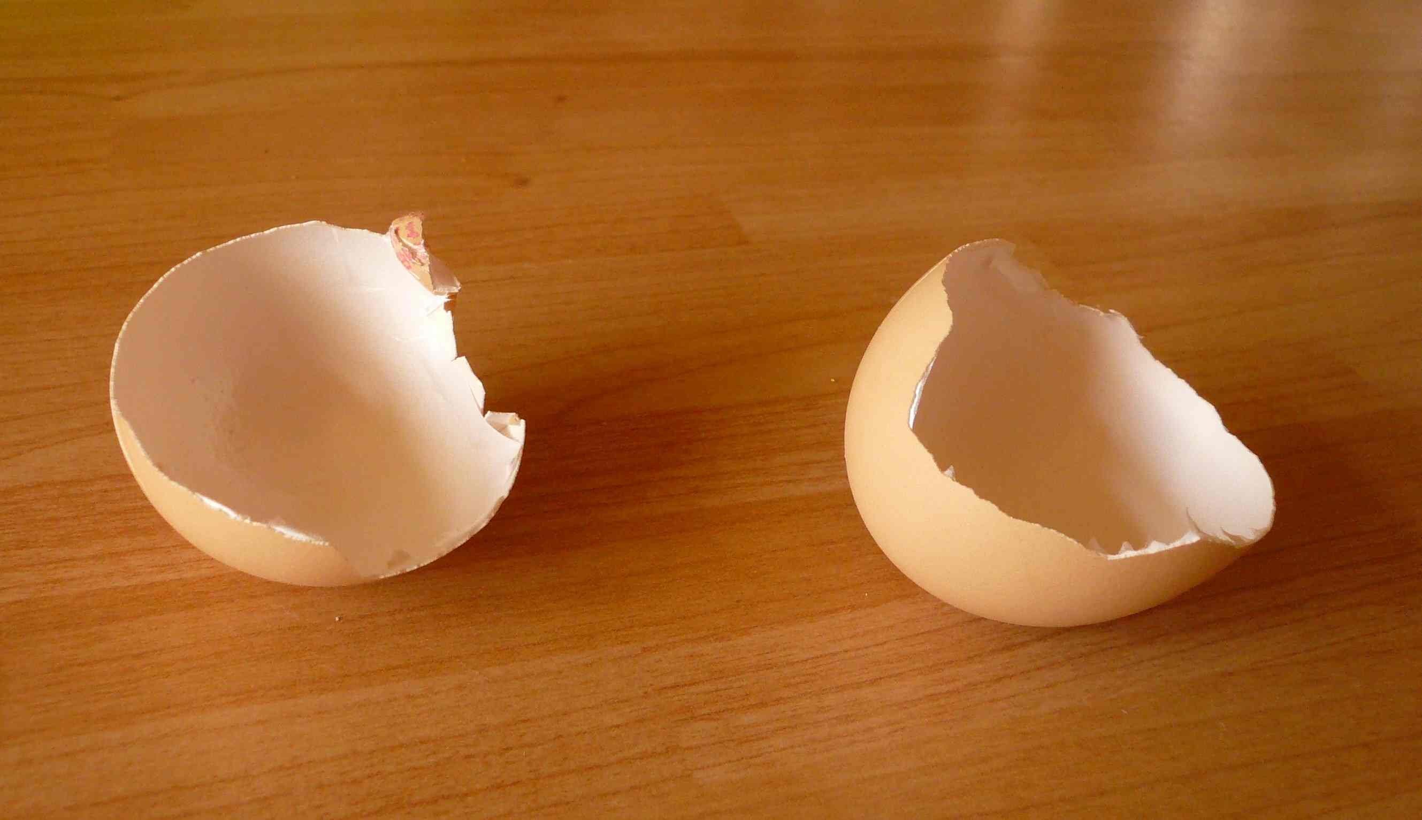
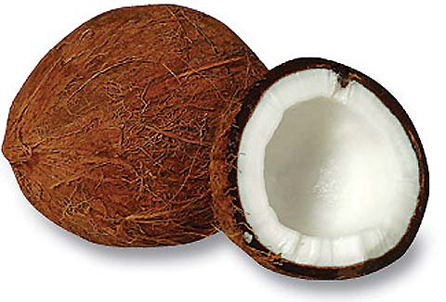
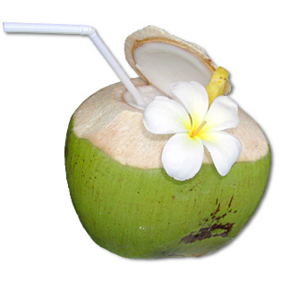
Q-ball profiles
cue-ball

Slide 5
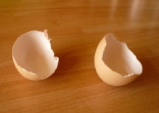

Three conditions for stable Q-ball
[Friedberg et. al. ‘76; S.R. Coleman ’85]
Existence condition:
  Potential should grow less quickly
  than the mass-squared term
  (radiative or thermal corrections, non-linear terms)‏
  Thin wall Q-ball for lower limit
  ”Thick” wall Q-ball for upper limit
Absolute stability condition:
  (Q-ball energy) < (energy of Q free particles)
Classical stability condition = fission stability:
  Stable against linear fluctuations and smaller Q-balls

Slide 6
Our work
Polynomial potentials
Non-linear terms due to thermal corrections
Gaussian ansatz has problems in the thick wall limit
Gravity mediated potentials
SUSY is broken by gravity interaction
Negative pressure in the homogeneous (Affleck-Dine) condensate
Similarity of energy densities for baryonic and dark matter
Gauge mediated potentials
SUSY is broken by gauge interaction
long-lived Q-balls
Dark matter candidate (baryon-to-photon ratio)

Slide 7
Our Results – SUSY Q-balls
O = stable, △ = stable with conditions, X = unstable
Energy of Q-ball ∝ Q ^{γ}
Thin wall Q-balls in gauge-mediated models
are most stable with a given charge !

Slide 8
By A. Kusenko ‘06

Slide 9
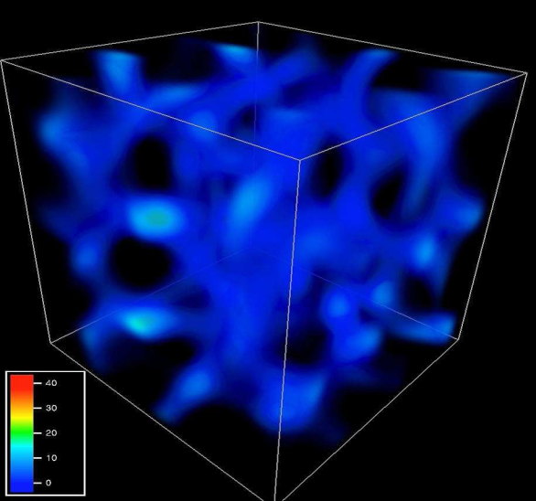
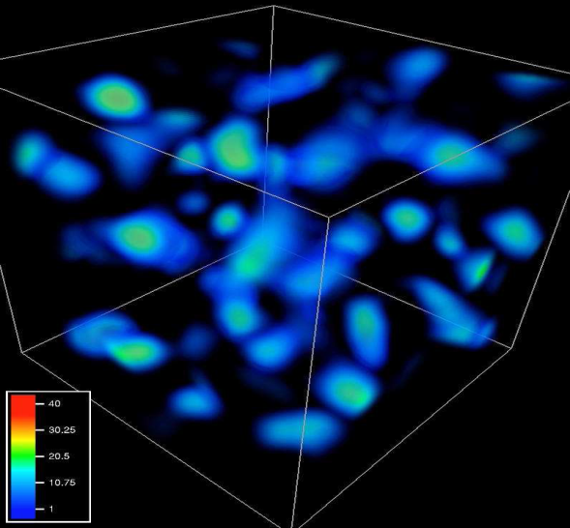
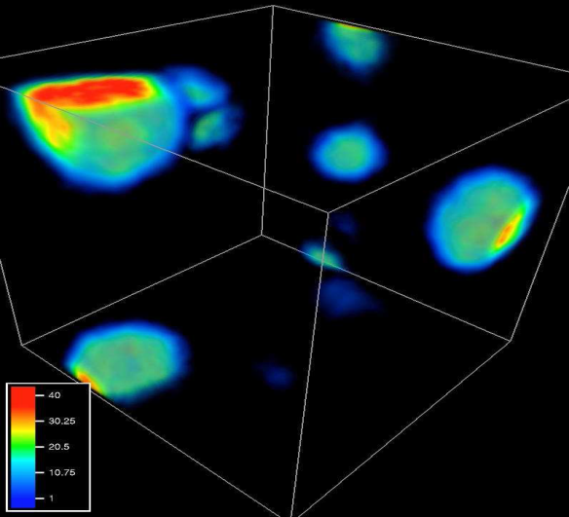
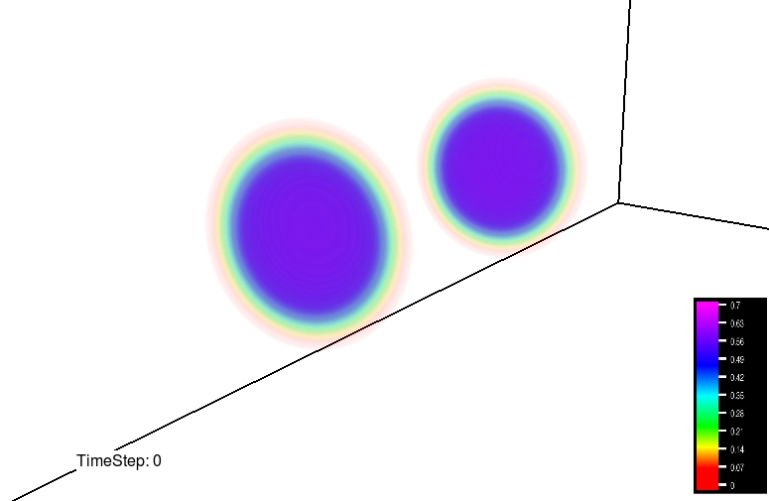
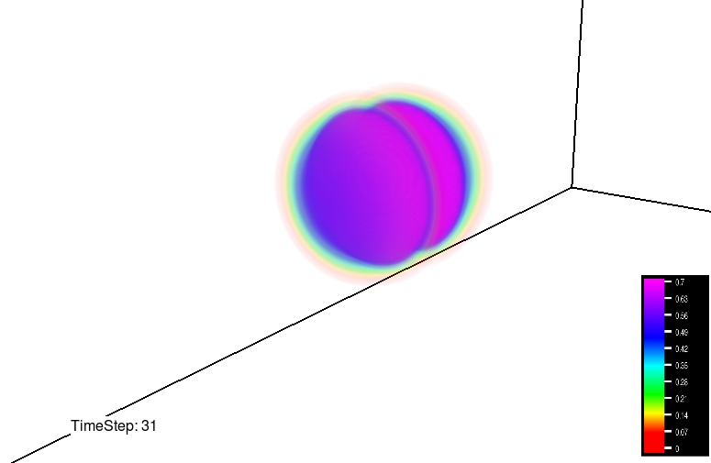
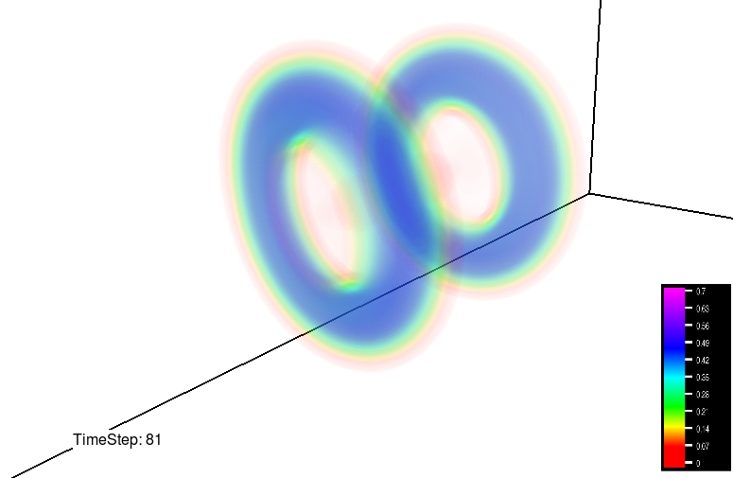
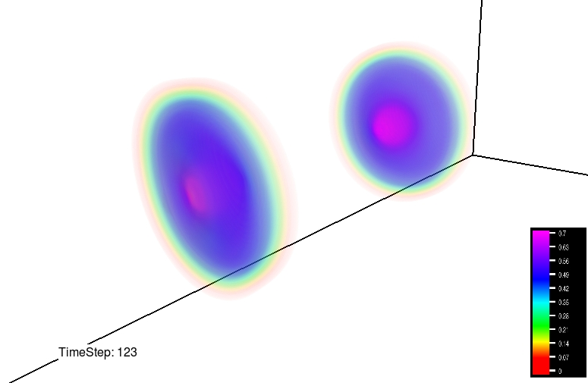
Formation and Dynamics [M.I.T.]
Two Q-balls out of phase
bouncing off
rings
collapsing
COSMOS (Cambridge) and JUPITER (Nottingham), VAPOR (www.vapor.ucar.edu )‏
LAT field (Neil Bevis and Mark Hindmarsh)

Slide 10
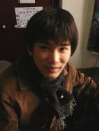


Conclusions
Q-ball has a long history since 1976
Stability of SUSY Q-balls
-> possible Dark matter candidate
Q-ball formation and its dynamics
For more detailed results, look into our papers:
+
+
= [arxiv: 0805.3233, 0905.0125]

Slide 11
END

Slide 12
Head-on collision between two Q-balls
[M.I.T. ; Battye, Sutcliffe ‘98]
Ansatz for two Q-balls with a relatative phase
In phase:
Out-of phase:

Slide 13
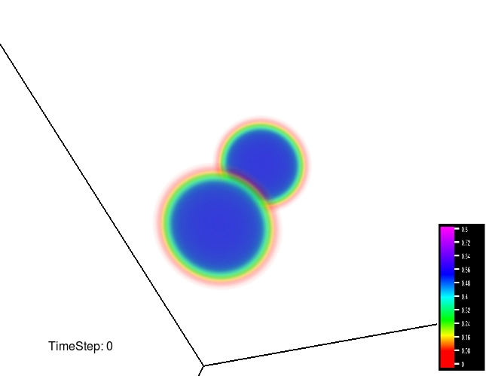
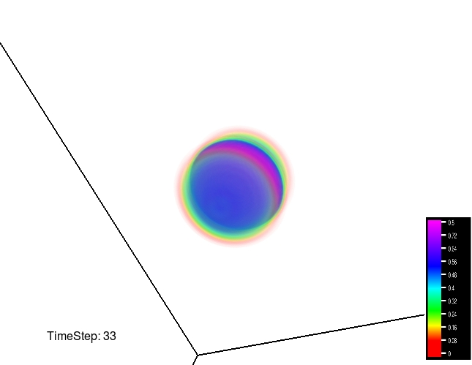
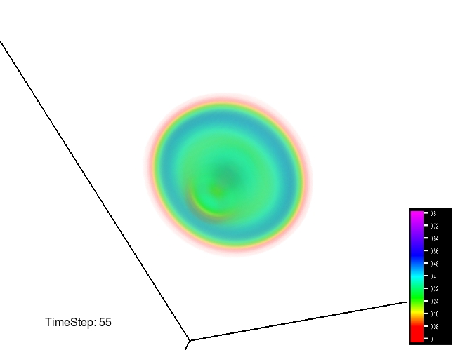
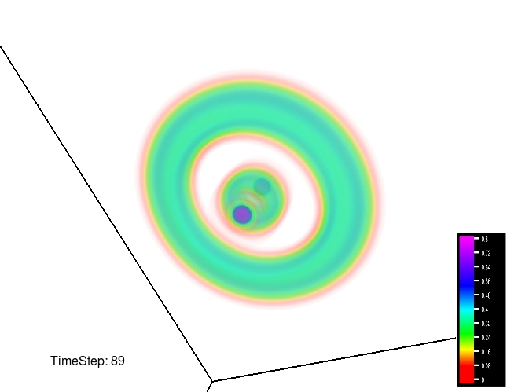
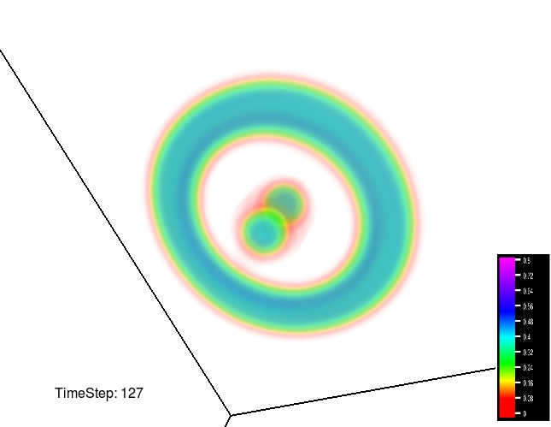
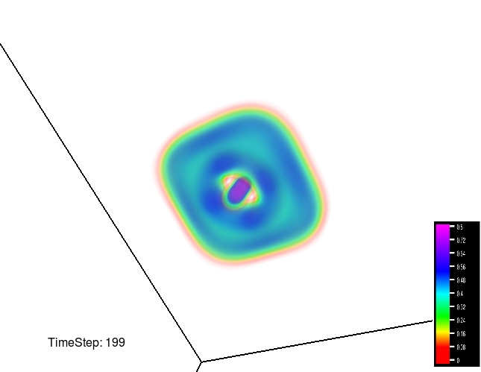
IN PHASE
merging
rings
rectangular ?
effects from boundary conditions ?

Slide 14
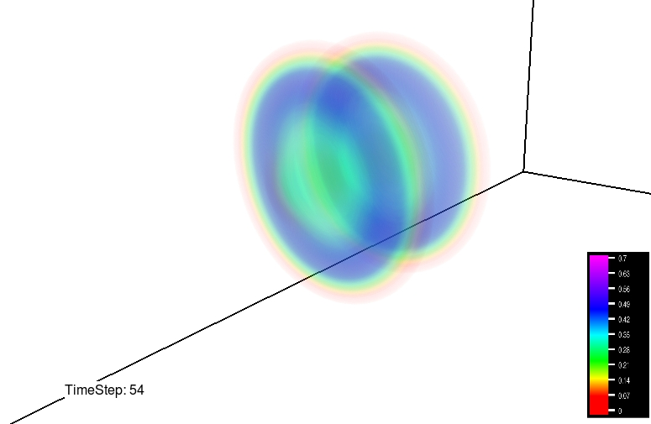
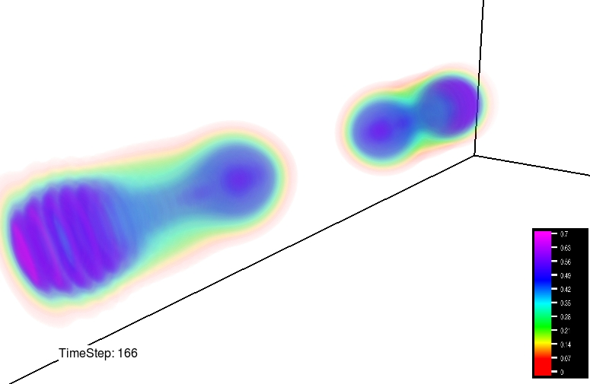
OUT-OF PHASE
bouncing off
rings
collapsing

Slide 15
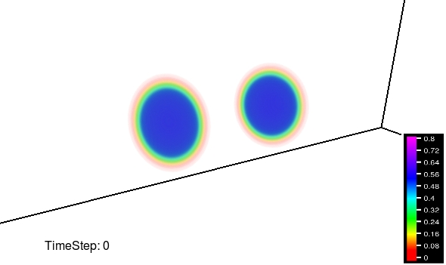
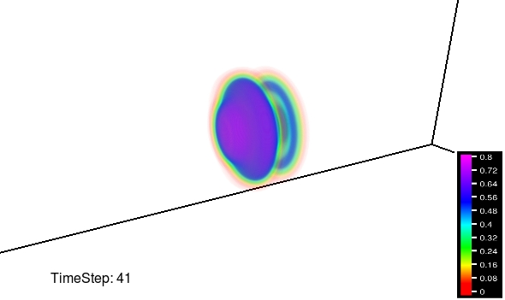
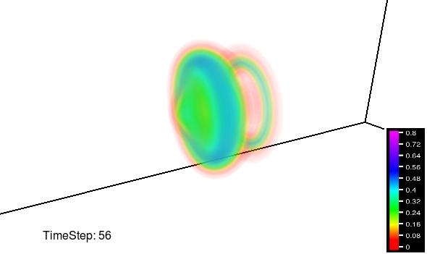
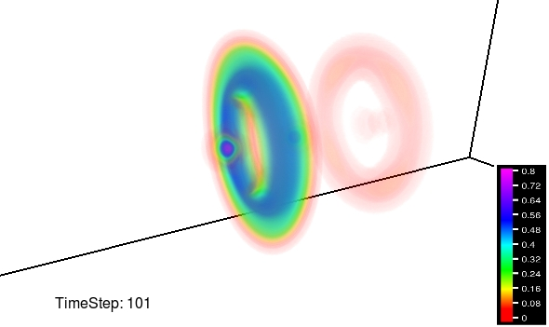
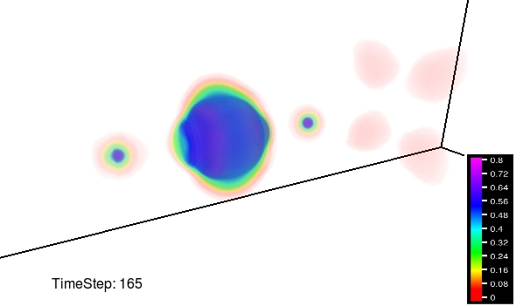
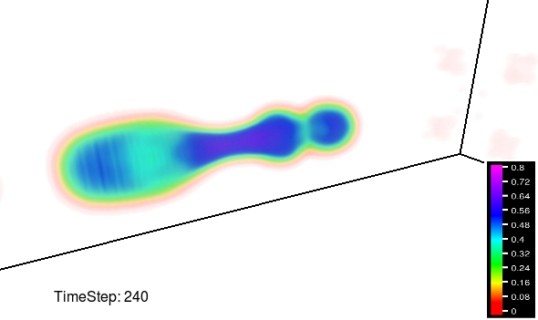
HALF-PI PHASE [M.I.T.]
Bouncing off
charge exchange
rings
radiating away
collapsing
Notes:
15

Slide 16
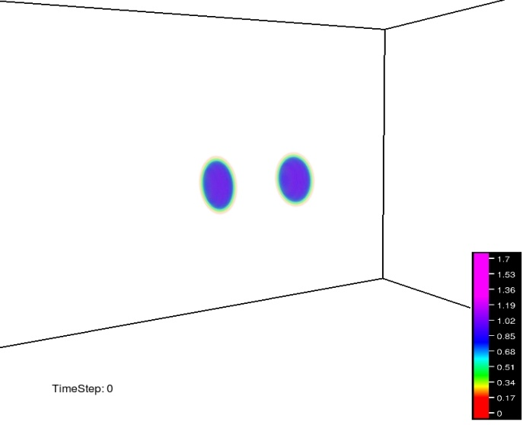
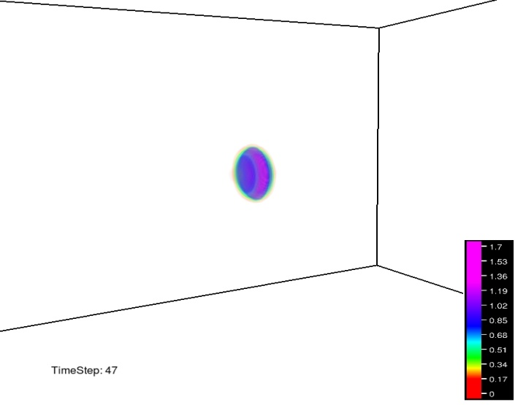
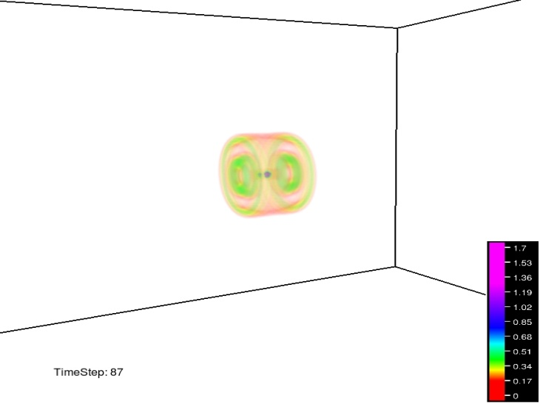
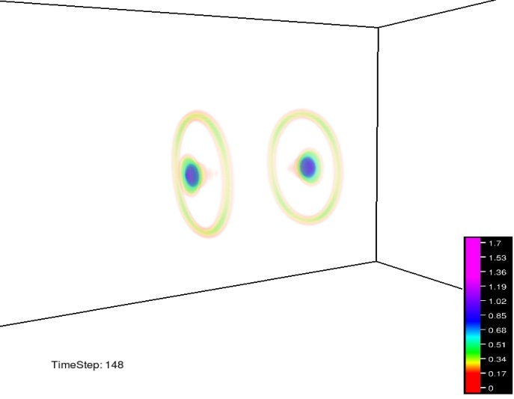
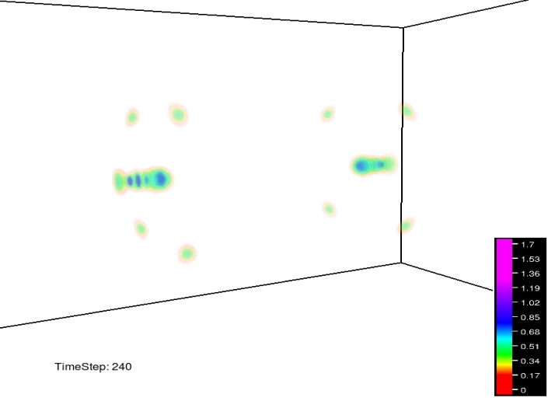
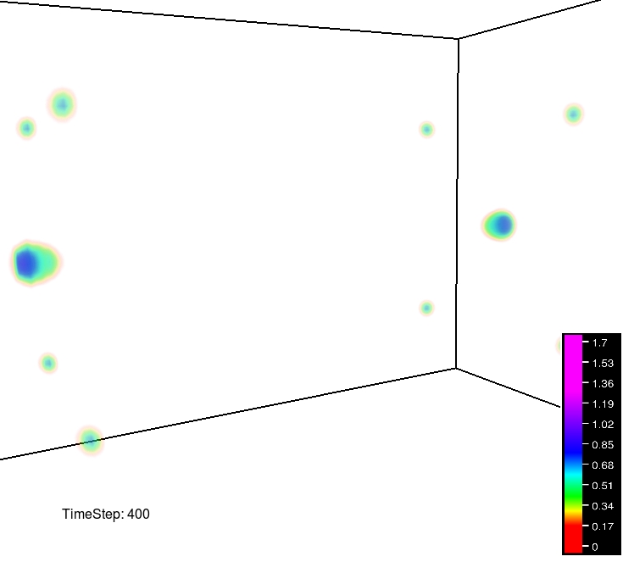
IN PHASE with faster velocity
Passing through
no charge exchange
rings
expanding
Notes:
16

Slide 17
Virial theorem
-generalisation of Derrick’s theorem
[A. Kusenko ’96; M.I.T., Copeland, Saffin ’08 & ‘09 ]
Q-ball exists in any spatial dimensions D
Given a ratio U/S between potential energy U
and surface energy S e.g. U>>S, U~S, or U<<S,
one can obtain characteristic slopes
Characteristic slope:
(Q-ball energy) / (energy from U(1) charge)‏
Gives proportional relation between energy and charge
Strong tool without the need for
    any detailed profiles and potential forms

Slide 18


Thin wall Q-ball (Q-matter, “cue”-ball)
Step-like ansatz [Coleman ’85]
No thickness
Negligible surface energy U >> S
Characteristic slope matched with the one from Virial theorem
Absolute stability without detailed potential forms
Only extreme limit of :
taken by Lubos Motl

Slide 19
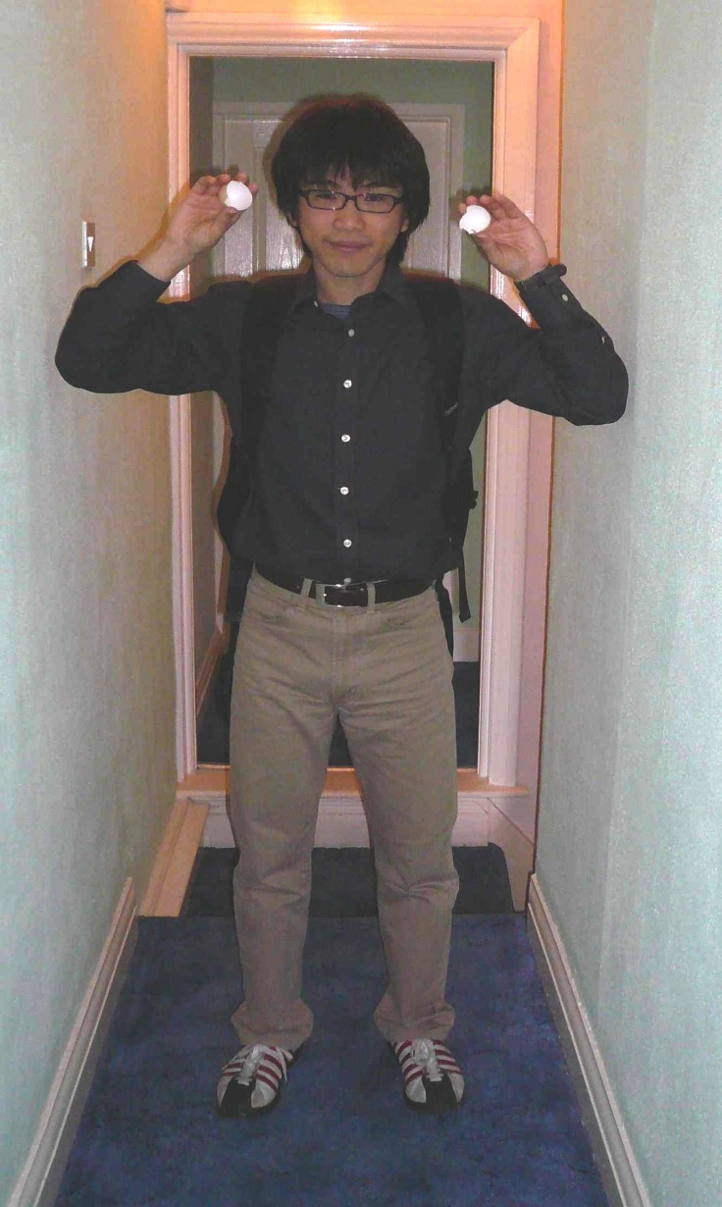

Thin wall Q-ball (Q –”egg”)
Egg ansatz [Correia et.al. '01; M.I.T., Copeland, Saffin ‘08]
Include thickness
Valid for wider range of
Non-degenerate vacua potentials (NDVPs): existence of “cue”-ball ( U >> S )
Degenerate vacua potentials (DVPs): U ~ S
Each characteristic slopes for both DVPs and NDVPs matched with
the ones from Virial theorem
Classically stable without detailed potential
Threshold value for absolute stability depends on D and mass
Relying on approximations:
  core >> thickness
  surface tension independent of
  potentials are not so flat

Slide 20
“Thick wall” Q-ball (Q-”coconut”)
Gaussian ansatz [M.I.T., Copeland, Saffin ’08; M. Gleiser et al ’05]
Valid for and only for D=1
Negligible surface energy (U>>S )
Characteristic slope matched with
the one from Virial theorem
Analytic Continuation to free particle solution
Contradiction for classical stability in polynomial potentials

Slide 21
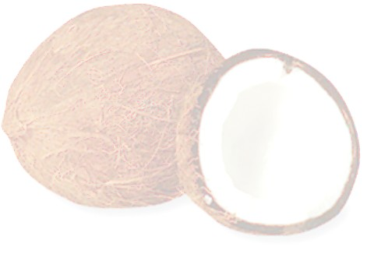
“Thick wall” Q-ball
Drinking coconut ansatz
[Correia et.al. '01; M.I.T., Copeland, Saffin ‘08]
Legendre transformation (straw)
and re-parametrisation
Valid for and for higher D
Analytic Continuation to free particle solution
Negligible surface energy (U>>S )
Characteristic slope (coconut milk) matched
with the one from Virial theorem
No contradictions for classical stability
Classical stability condition (coconut milk)
depends on D and model

Slide 22
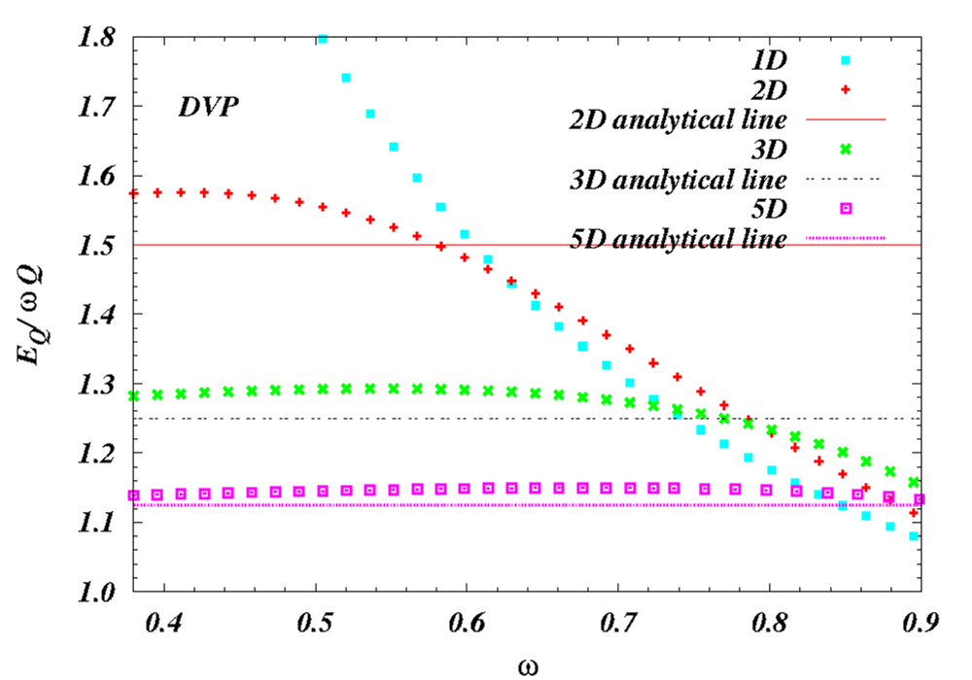
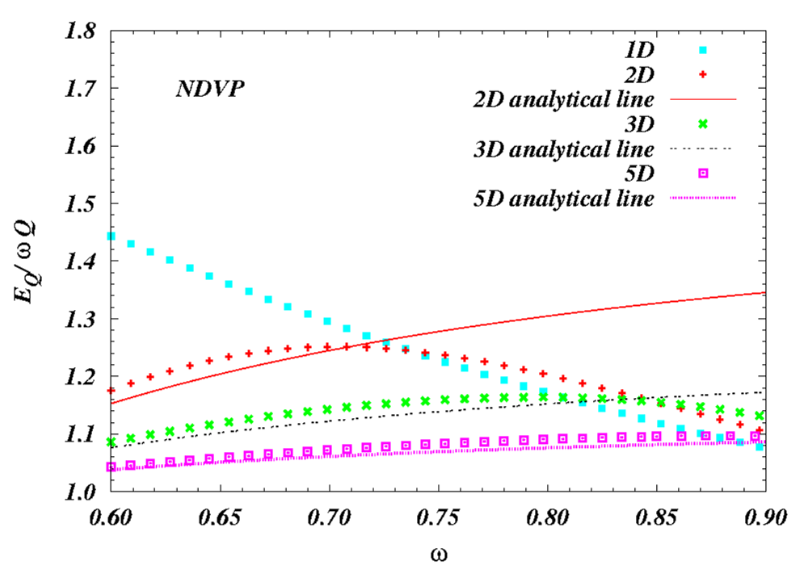


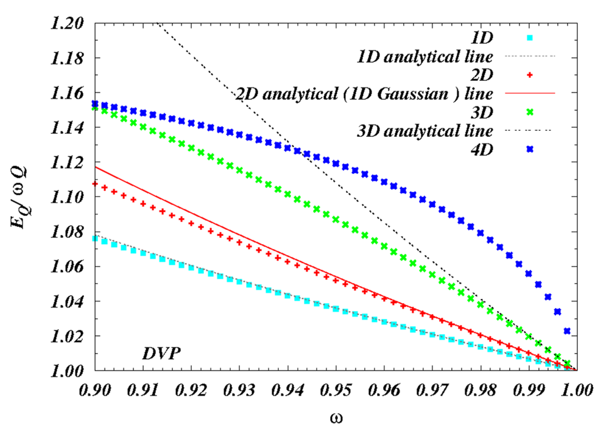
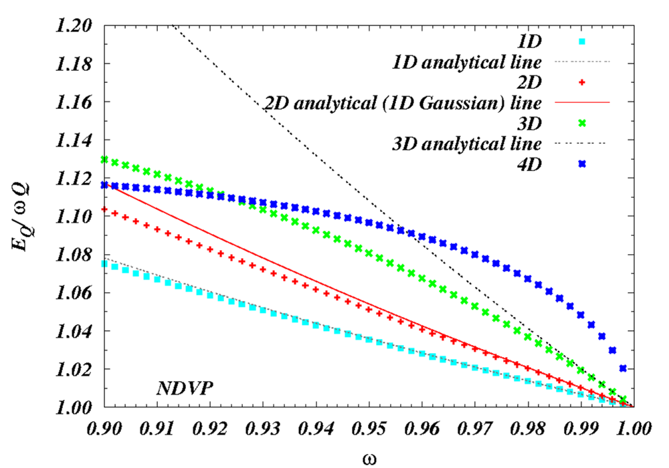


DVP
NDVP
Thin wall approximation
DVP
NDVP
Thick wall approximation

